Slide 1
LatentView capabilities in enabling data driven ecosystem
January, 2019

Slide 2
Agenda
1
Confirmation on business use case
2
LatentView POV on ideal data platform
3
Case studies

Slide 3
Business use case
Data
Collection
Data
Harmonization
Data
as a Service
Data needs to be collected from third party systems for integration with in house data for multiple use cases:
Internal Data
External Data
All the collected data from different sources are loaded in the form of a data mart / data cube. Relationship needs to be established between multiple data sources. This can be done in one of the following two ways:
In House Data Base
Using Cloud
Enabling the stakeholders to utilize the data for multiple use cases like below :
Reporting/Dashboard
Adhoc analysis
Advanced analytics
Integration of existing applications

Slide 4
LatentView POV on ideal data platform

Slide 5



Key questions to enable data as a service
Key questions that need to be addressed
Data Lake Creation
Analytics Engine
1
2
3
How to acquire data?
How to create a unified data view?
How to enable consumption?
Identify the correct tools to combine data from different sources based on the data type
Prioritize between clouds based platform vs an on premise data lake creation, based on business requirements
Enable support for Visualization or Machine learning techniques like Forecasting, clustering and other advance analytics

Slide 6
Ideal data platform and design considerations
Ingestion & Storage
Data Variety
Mostly Structured
Disparate systems for Unstructured
Traditional ETL
Data Volume
Limited Capacity
On Premise Considerations
Scheduled Archival & Restoration
Transformation
Data Veracity
Data Silos
No central view of metrics
Lack of metadata and lineage
Data Velocity
Tightly coupled dependencies
Cascading failures
Information Delivery
Analytics Workloads
Data Warehouse for all use cases
Reporting
Advanced Analytics by Business
Throttling usage
Access restrictions impacts lead time
Enablers
Process – SLAs
Technology – On-premise, Cloud, Hybrid
Cost – Accountability & Process Transparency
Deployment – Prototype to Production
Data Governance & Security
ACLs

Slide 7
Business focused and workload centric architecture
How to acquire data?
How to create a unified data view?
How to enable consumption?
CANNED REPORTS
Data Integration
Relational Data Store
(Ex: AWS Redshift)
Enterprise Reporting Platform
Conventional Data Sources
Structured
Data Lake
(Example: S3)
SELF SERVICE BI
Unconventional Data Sources
Indexing and Querying
(Ex: Elastic Search)
API endpoints
OPERATIONAL
External Data Sources
Unstructured
Machine Learning Workbench
ADVANCED ANALYTICS
Distributed Processing
Feature Engineering
Data Sampling
(Ex: Spark)
Internal Data Sources
Real time Indexing
(Ex: Elastic Cache)
REAL TIME REPORTING
Workload Aware Compute
Data Type specific ETL toolset
Isolating Compute from Storage
7

Slide 8

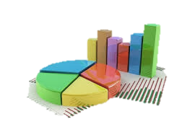
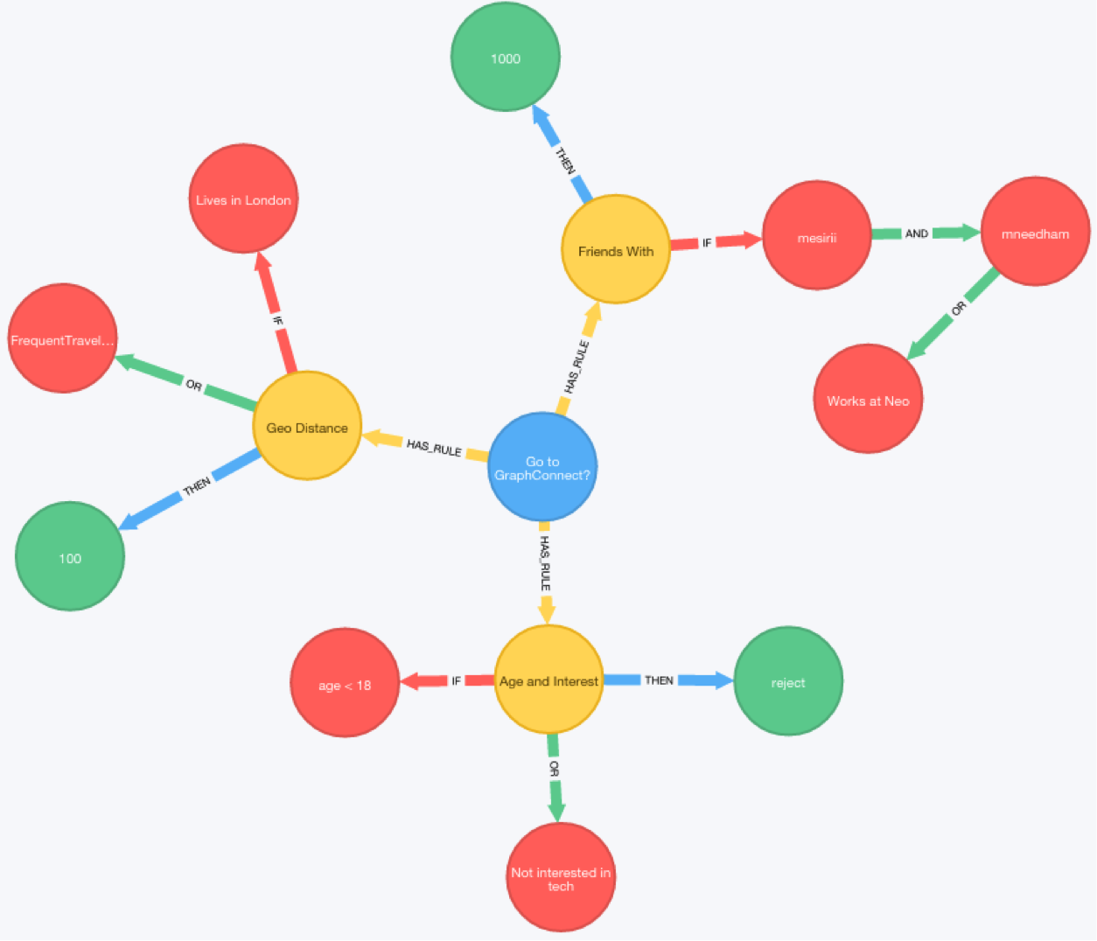





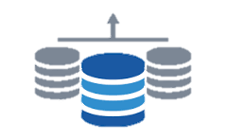
Reporting platforms & features
Relational/Graph database
Web based tool
BI tools
Traditional SQL interface
Highly structured
Extensive support
Graph database
Flexible
Easy navigation
Custom web based tool
Chatbot
Voice enabled reporting
Custom applications
User specific access
Tableau
Domo
QlikView
Power BI
Excel reports
MicroStrategy

Slide 9
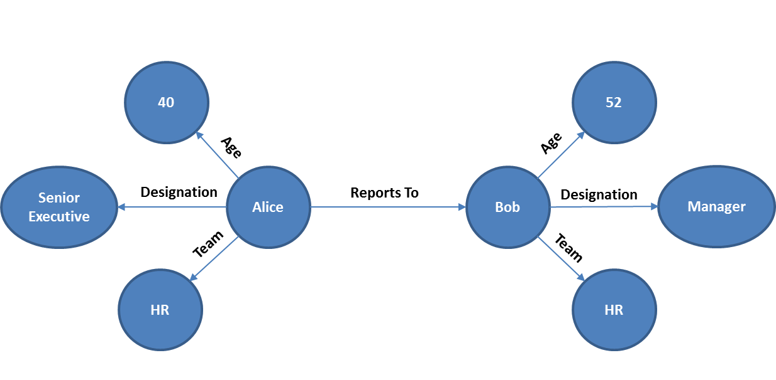
Graph database
Graphs provide an efficient way to store relationships between entities and navigate through them easily. A graph data model consists of nodes/vertices that represent the entities in a domain and its associated attributes, and edges that represent the relationships between these entities.
For example, if Alice, aged 40 years and Senior Executive in HR Team reports to Bob, aged 52 years and Manager in HR Team, then the graph will contain nodes (Alice and Bob) that are connected to each other by a relationship (‘reports to’) and connected to their respective attributes such as Age, Designation and Team.

Slide 10
Case studies

Slide 11
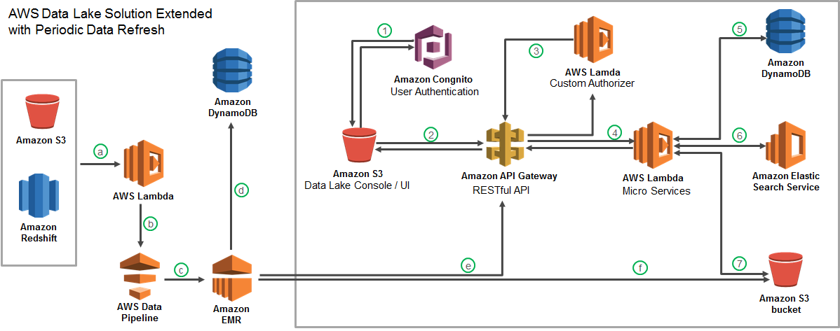




Cloud-based data lake to enhance analytics operations
Largest Food Distributor in the US
The Problem: Ageing legacy Business Analytics Infrastructure with high cost of ownership slowing down realizable analytics value
The “Before” State
LatentView Solution
The “After” State
Business users faced significant delays in accessing and analyzing data and had difficulty in handling large volumes of data for analytics
Migrated 60TB of data from legacy systems into a cloud based data lake with extended periodic data refresh which supports reporting and advanced analytics solutions
Reduced cost of ownership and increased throughput of cloud hosted analytics solutions
Recommendation Engine
Order Anomaly Detection
Product Substitution
Revenue Management Use Cases
11

Slide 12

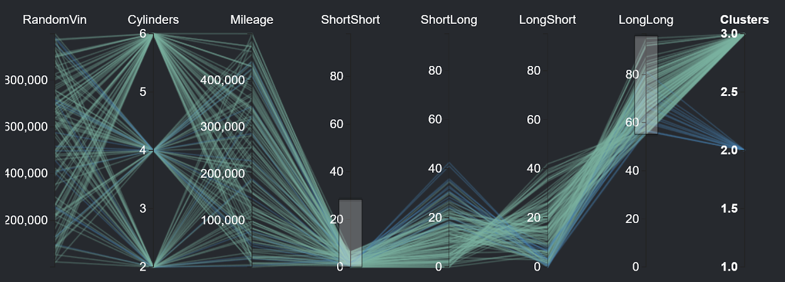
Risk identification by modeling customer behavioral patterns
Europe-based Iconic Automobile Manufacturer
The Problem: Costs incurred due to warranty claims had a negative impact of almost 2.5% on the bottom line
The “Before” State
LatentView Solution
The “After” State
Warranty claim predictions were based on an historical average computed across all categories of drivers
Driving styles were identified based on vehicle usage and historical warranty claims which were then used to accurately predict future claims for each driving style
Warranty costs reduced by 35% for the “long pause and short trips” driving style due to proactive ‘drive right’ messaging communicated to at-risk drivers
Controller Readout Data
Hypothesis Testing Tool
Output
C1 – > 30K/Yr, 30% Long Trips, 25% - Acceleration > 200KMPH
Typical Issues:
Head Gasket Failure, Soot in the oil, Engine mount issues
Calculated Risk: €2.400,00
Risky Clusters: C2, C6
Cause: High Acceleration in winter without heating
Notes:
BMW – Hypothesis Testing
http://ec2-52-14-99-198.us-east-2.compute.amazonaws.com:8080/
Business Objective:
Improve the throughput in production line for a plant having Operational Equipment Efficiency (OEE) due to impact of packaging segment stops contributing to fryer downtime / throughput reduction
LatentView Solution:
Driving Styles
Identify key driving styles using the vehicle controller data
What are the main driving styles?
Warranty Claims
Compare driving styles with warranty claims data
Are there claim patterns to individual styles?
Automated Hypothesis Testing
Use the tool to identify risk groups by dynamic profiling
Continuous Hypothesis Testing
Process:
Data collected:
1) Vehicle Usage from Connected Data - Driving Styles
2) Warranty & Repair Data - Repairs & Risk Patterns
Output:
Driver Segmentation, Risk Prediction & Maintenance at each Car (VIN) level

Slide 13








Meet IRA - Amazon Lex powered innovation radar
Client: Leading Home Appliances Manufacturer in US
Ease of Use
IRA can be a faster alternative for Innovation Radar to search for answers to questions around consumer feedback across Whirlpool and competitor brands via simple conversations
Flexibility & Scalability
IRA also provides output in the form of charts and scans millions of records to deliver the right insight to the right person
BENEFITS OF
To access
test version of IRA
Personalization & Deep Dives
IRA can provide both high-level as well as granular insights based on the business query
AI driven UI
IRA’s user interface (UI), is driven by artificial intelligence (AI) incorporating Amazon Lex
Notes:
Innovation Radar : https://globalinnovationradar.com
Chatbot IRA : http://ec2-52-200-210-195.compute-1.amazonaws.com:5000/

Slide 14
Social insights platform for a leading multinational in cosmetics
Enabling easier consumption of complex unstructured data with custom build application and open ended search on the database
Spot trends for Competitive Advantage
Identify beauty trends ahead of time
90 Million Conversations
Neural networks
Image Classification, spam removal and sentiment analysis
Revlon
Brands
Win in the Marketplace
Protect & Enhance Brand Value
Understand customer perceptions and purchase intent to help retain customers
against smaller competitors
Understand customer perceptions and purchase intent to help retain customers
against smaller competitors
Benchmark brand reach, engagement and evaluate campaign effectiveness
ML
Trend prediction
Notes:
Revlon – Trendspotting

Slide 15
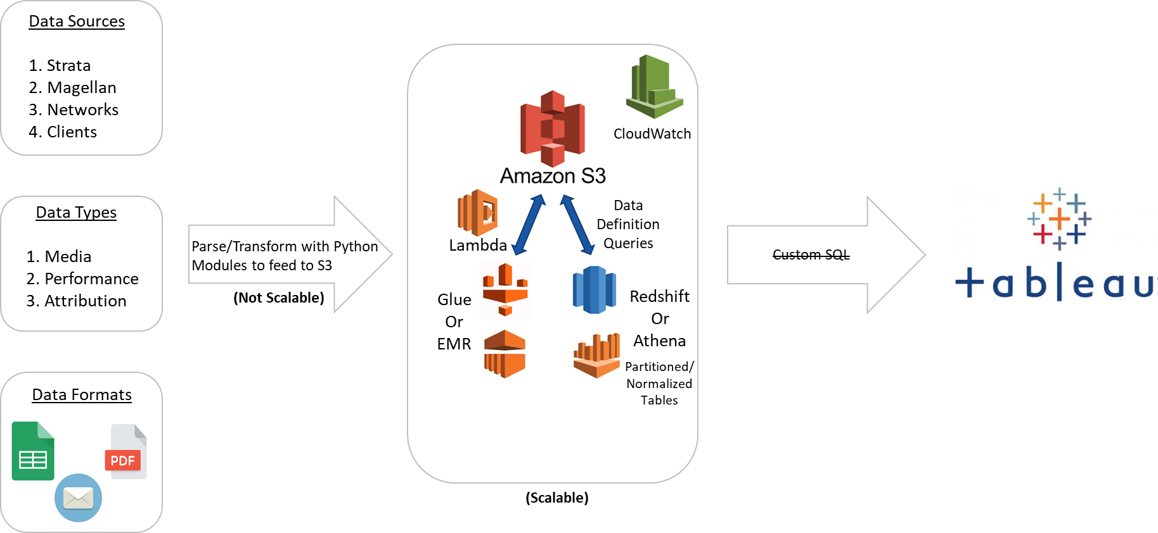
Centralizing media data from media buying platforms
For a leading client in Advertising and Marketing industry
The Problem: Lack of data quality, management and governance leading to heavy dependence on analysts’ manual efforts for weekly reporting
The “Before” State
LatentView Solution
The “After” State
Business users faced significant delays in on boarding and publishing reports. Ad-hoc analysis were not supported to a larger extent
Centralized, Cloud based and Scalable approach was introduced and implemented. Normalized Database design – Dimension Data Model
Dashboard timeliness reduced from 24 hours to less than 30 minutes reducing 50% cost of development
Reduced 80% of manual work and dependence of analysts
Business Benefits
Collect and store any type of data, at any scale, and at low cost.
Secure the data and prevent unauthorized access
Catalog, search, and find the relevant data in the central repository
Quickly and easily perform new types of data analysis, predictive analytics, artificial intelligence (AI), and machine learning
Notes:
Oxford Road
Oxford Road producing and placing ads on traditional media channels like television, terrestrial and satellite radio, new media channels such as streaming audio and video, and on-demand content like Podcast and Video On Demand(VOD).
Requirements
Centralizing media data from Media Buying Platforms (Postlog, Strata)
Appending performance data from Google Analytics, client e-mails
Enriching data from third party data sources
Automation of Data Loading and Report publishing
Challenge
Company wide data silos
Lack of data quality
Lack of data management and governance
Heavy dependence on analysts’ manual efforts for weekly reporting
Issues with the Current System
Timeliness – More time on client on boarding and reports publishing `~ 24 Hours – Manual Process
Flexibility – Not supporting ad-hoc analysis
Quality – No Data Model and Lineage
Findability – Hard for Non-IT people/ Business Analyst
Scalability – Unable to process the large volume of data
Advantages of our Solution
Centralized, Cloud based, Scalable approach
Normalized Database design – Dimension Data Model
Modular Codes
Configurable externally
Other Key Benefits:
Dashboard timeliness reduced from 24 hours to less than 30 minutes.
Reduced 50% cost of development and testing using local development environment
Reduced 80% of manual work and dependence of analysts
Collect and store any type of data, at any scale, and at low cost.
Secure the data and prevent unauthorized access
Catalog, search, and find the relevant data in the central repository
Quickly and easily perform new types of data analysis, predictive analytics, artificial intelligence (AI), and machine learning.

Slide 16
Appendix
LatentView Confidential

Slide 17
Challenges and complexity in unifying data
Technical Challenges
Environment (Cloud / On-Premise)
Architectural Design
No. of Users
Processing Time
Enabling A/B testing environment
Enabling Change Management
Data Duplication
Mapping / Connecting data
Data Coverage
No maintenance of Infrastructure required
No high investment required: Pay by usage
Highly scalable
Data centralization-Effective data collaboration
across cross-functional teams
Improved business agility and operational efficiency
resulting in competitive edge
Helps in improving the time to launch of campaigns
Automatic software updates
Pros & Cons of Data in Cloud
Security issues: IT team’s guidance necessary to keep it safe
Incompatibility with current software & applications
Lack of support, unplanned outages from cloud providers is sometimes a grey area

Slide 18
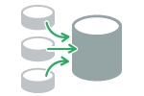
Creating data mart for all analytics use cases
Leading American multinational computer software company
Business Objective
To build better customer relationships and acquire new customers by segmenting their customer base
To create a DataMart for Analytics use cases like developing a look-a-like model and understanding the changing customer base
LatentView Solution
Created a DataMart with internal variables of Adobe for 1.4M customers
A single table was produced as final output with 6M records consisting of ~2K fields for all analytics use cases
Production environment was materialized to run daily in Hive using Oozie
Benefits & Output
Adobe was able to develop a look alike model for the segments created
Customer base was finally classified under segments based on demographics, characteristics, session level info, web analytics data and marketing response
Challenges
Customer ID’s had duplication issue across multiple countries
Not all ID’s were mapped with multiple data sources
Metrics were repeated across tables for which the resource intensiveness and the coverage of the metric were considered to overcome the issue
Data Sources
Data Mart
Final Segments
Acxiom Data
Creative for pay + Creative Climbers
Fame and Fortune
Utilitarian
Private Hobbyist
Applause Seekers + Engaged Expressive
App Launch Details
Email Domain Details
Feature Level Data
Marketing Responses
Web Analytics Data
Notes:
Adobe

Slide 19
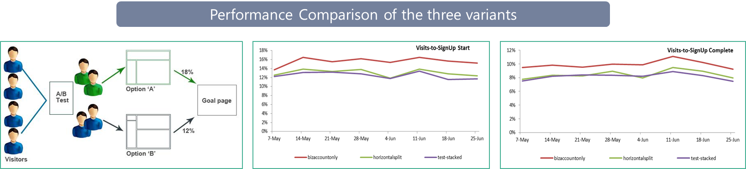
A/B testing for a global online payment solutions provider
Leading Online Payment Solutions Provider
The Business Objective
Improve Merchant account acquisitions by providing a easy-to-use page layout on the website
Alternatively, test the performance of three variants of the same Page (with different layouts), live at the same time
LatentView Solution
Established the homogeneity of traffic to the variants of the page to isolate bias Analyzed the performance of the pages in terms of conversions and engagement using Site catalyst, Google Analytics & SQL
Regular tracking to establish consistent and significant performance improvement
Business Benefits
Analysis resulted in identifying the page which results in highest merchant account acquisitions and activation
13% increase in activations within 60 days of account signups from the Winning variant compared to the Control

Slide 20



AI / ML to drive business impact
Business Planning
Demand Prediction
Market Strategy
Strategic Investments
Early Warning Alerts
Customer Complaints
Transactional Risks
Loss Prevention
Innovation / Insights
Voice of Consumer
Competitive Intelligence
Product Governance
Customer Engagement
Personalization
Acquisition & Conversion
Customer Experiences
Self Serve Analytics through Micro Applications
Complex Data Linearly Scalable With Data Volume
Faster Time To Market Due To Less Set Up Time
Artificial Intelligence / Machine Learning
Integrated & Disparate sources in Data Lake

Slide 21

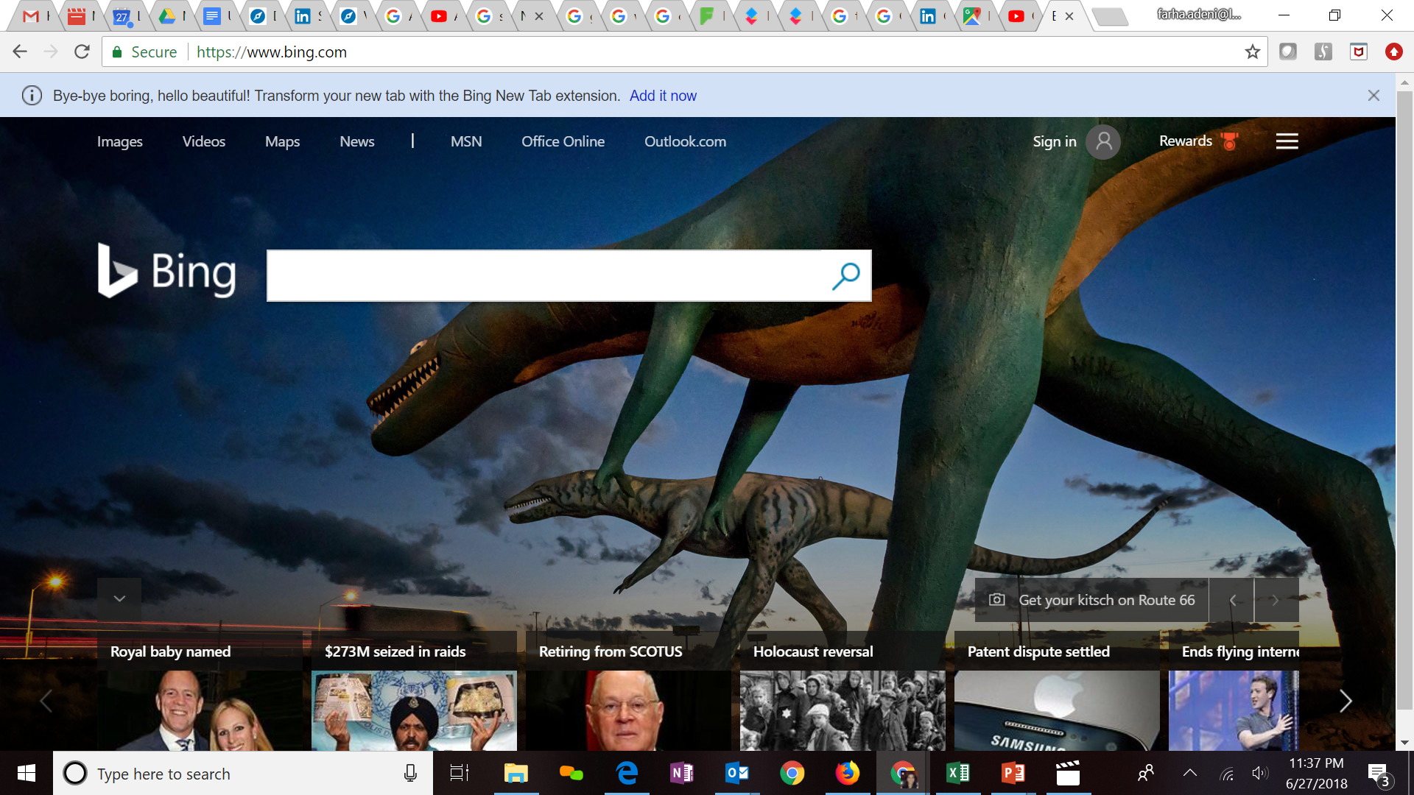







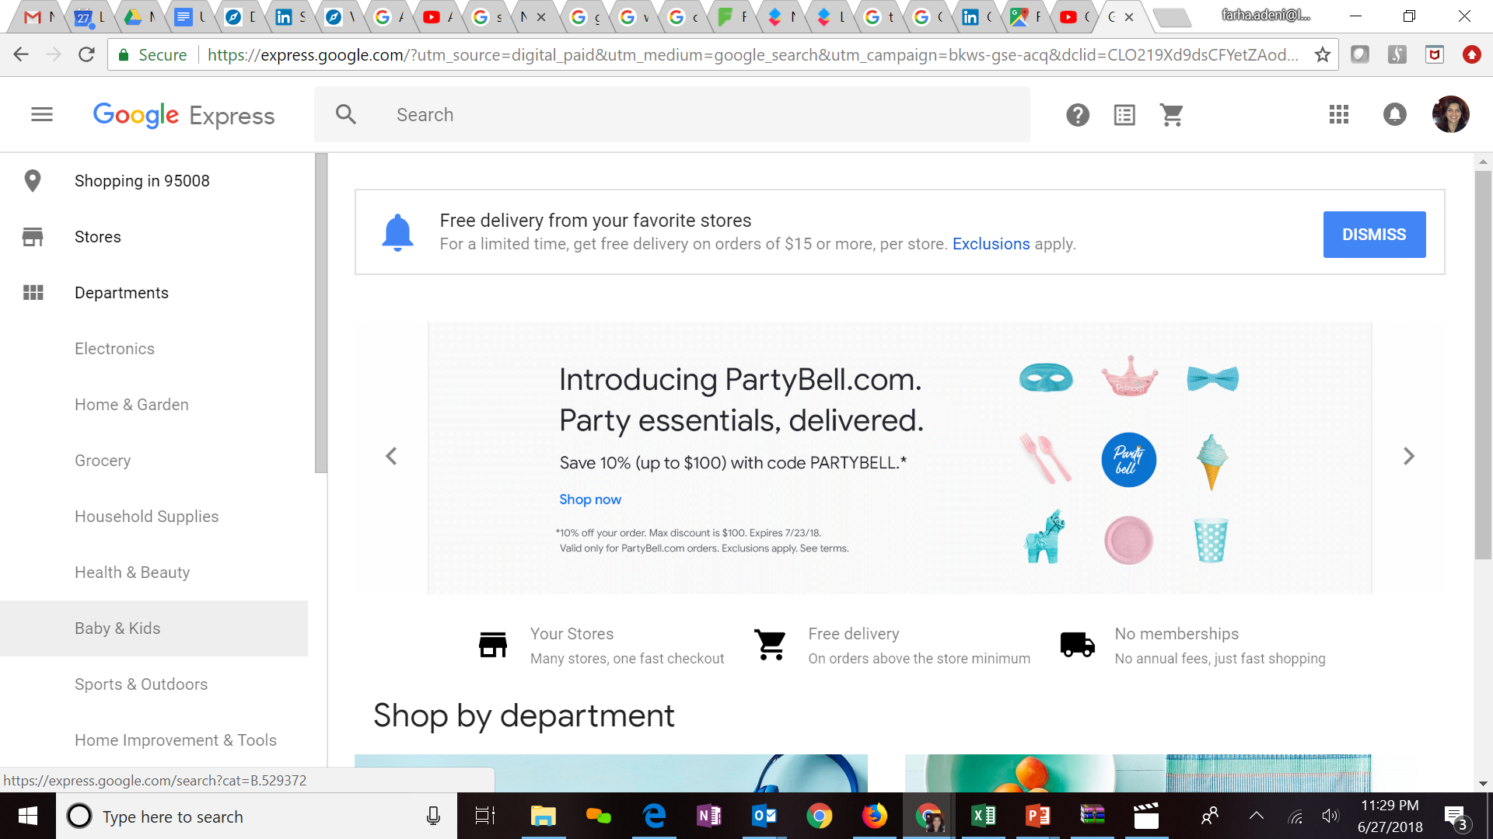
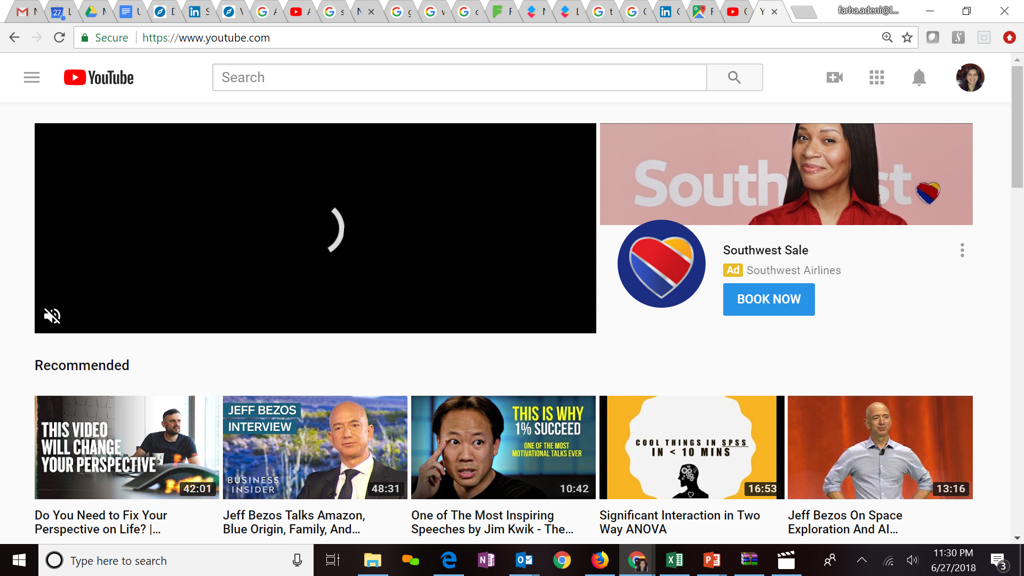
Expertise in cloud platforms
Key Clients
LatentView is a Microsoft Gold Analytics Partner
Model Automation Framework – LatentView scalable ML solution built in Azure hosted on Microsoft Appsource (link)
Key Participants of MS Tech-ED 2014, Azure Training
Managed Analytics in Azure using AzureML, PowerBI, Azure data factory, Azure Search, Azure data lake analytics etc.
LV is Advanced Analytics Consulting Partner
Key Presenters of AWS Re-Invent, Business Summit
60 TB cloud migration exercise completed in 3 months
Processing 500+ GB unstructured data per week
Multiple enterprise solutions deployment experience
Managed Analytics in AWS using Amazon ML, Cloudsearch, Kinesis, QuickSight etc.
Extensive experience in handling GCP products- AppScript, CloudSQL, Appmaker, Big Query etc. Deep Technical Capabilities to work in this platform
Multiple solutions deployment experience for Google projects
Managed Analytics in GCP using MapR, Cloud ML, Cloud dataflow, Google data studio, Cloud SQL
Notes:
Q – Anup can you update some of the details

Slide 22
Iterative framework
1. Business Understanding
3. Wireframe Design
2. Data Understanding
4. Dashboard Design & Development
Testing
Unit test
Data check
Data Manipulation
Enhancement-I
Review-I
Enhancement-II
Review-II
Enhancement-III
Review-III
4.a. ETL Team Testing
4.b. Business User Testing
4.c. UAT Testing

Slide 23



Drivers for data visualization
Who is my audience
Visual discovery of insights
Scalability
Usability
Summary to detailed reporting
Tracking right KPI’s
What is the no. of users
Which devices are supportive
Visualize overall summary for an executive level
To drill down for generating insights for operational level audience
Getting the right KPI’s to meet the business demands
Dynamic change in KPI’s for different set of audience
Visualization based on the number of users
Giving access to the authorized set of audience
Developing the visualization supporting multiple use case scenarios
Able to access from Desktop, Tablets & mobile phones

Slide 24
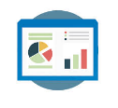




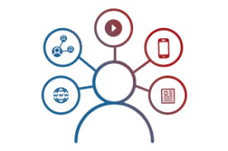


Making sense of the data
Reporting & Visualization
Performance Management, KPI Measurements
Monitoring & Control
Real Time Assurance, Audit & Compliance
Voice of Customer
Criticalities, Competitive Intelligence
Segmentation & Clustering
Personalization, Appropriateness etc.
Relationship & Causalities
Implementation, Strategy &
Prioritization
Digital Analytics
Consumer Journeys, Marketing Effectiveness
Experimentation
Experimentation at scale, A/B testing etc.
Integrated & Disparate sources in Data Lake

Slide 25













Reporting and visualization capabilities
Different forms of Reporting :
LatentView Visualisation Practices
Expertise in developing reports & dashboards using visualization tools like Tableau / DOMO / PowerBI / QlikView
Custom Web Tool development highlighting the key metrics across different sections in the form of an interactive dashboard
Integration of interactive Visualization in the web portals
Mobile Apps development which can help in giving updates on a periodic basis
Structure and Flow
Uncluttered
Integrate Text Graphics and Data
Enforce Comparison
Analysis and Insight Generation

Slide 26
Thank you
Email: Mahadevan.Balakrishnan@latentview.com
Phone: +91 44 4344 1718

